Slide 1

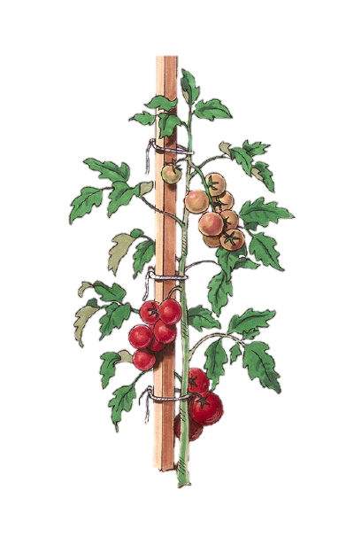

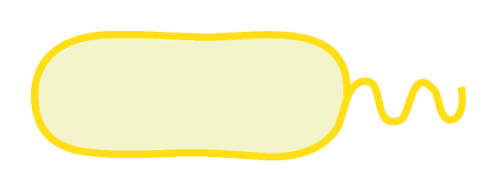
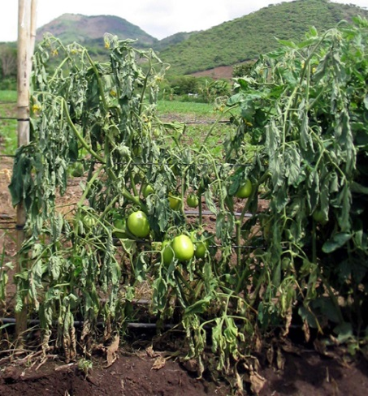
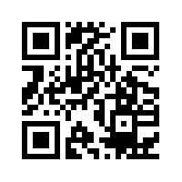
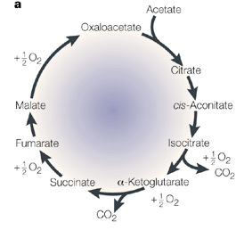
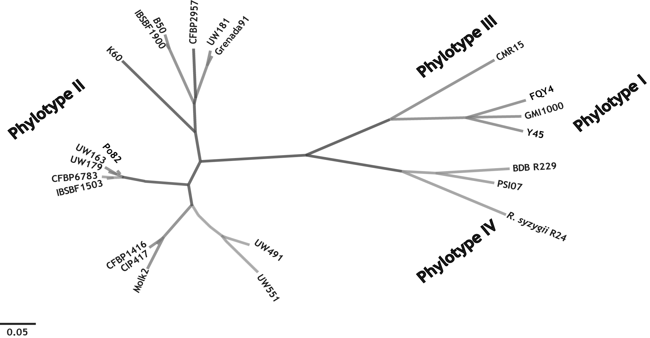
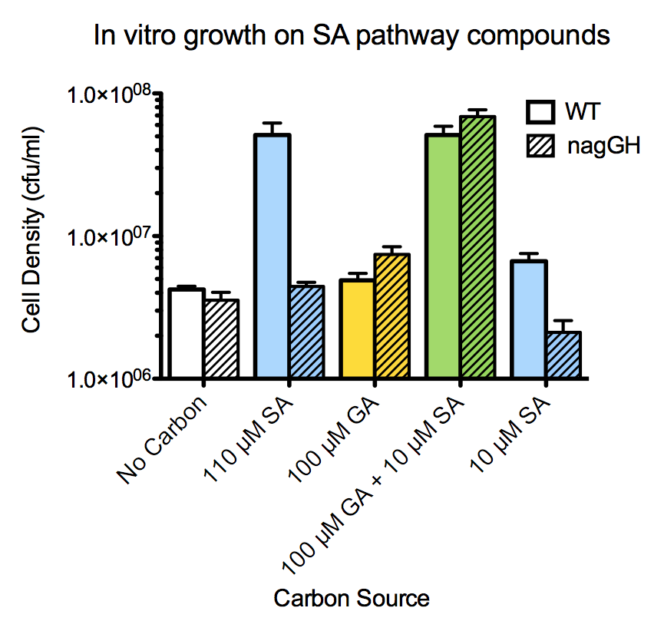


The pathogen Ralstonia solanacearum degrades the key immune signal salicylic acid during infection of tomato plants
Tiffany M. Loweª, Jon Jacobs^{b}, Florent Ailloud^{c}, and Caitilyn Allenª
ªUniversity of Wisconsin, Madison; ^{b}IRD, Montpellier, France; ^{c}CIRAD, Reunion, France
Background
A ΔnagGH strain cannot use SA as a carbon source and is more sensitive to SA toxicity
Video of Bacterial Wilt Symptom Development:
R. solanacearum causes bacterial wilt disease on many important crop species, such as tomato.
Salicylic acid (SA) is a key mediator of plant immunity
R. solanacearum-infected tomato plants express SA-dependent defense genes¹
Pretreating tomato plants with SA delays bacterial wilt disease²
The R. solanacearum effector PopS suppresses SA-dependent defenses in tomato²
In the plant, R. solanacearum expresses the nag genes which degrade SA via a gentisic acid intermediate³
Gentisic acid is a tomato defense signaling molecule⁴
http://vimeo.com/74855449 (Created by Jon Jacobs)
The Nag pathway breaks down the plant defense signals SA and gentisic acid
Strains grown in minimal media without carbon or with 0.1 mM succinate or SA. Growth was measured after 48 hrs.
Growth inhibition assay: Strains grown in complete minimal media with increasing [SA] added. Growth was measured after 48 hrs.
NagGH
NagI
NagK
NagL
TCA
Cycle
SA
NagAaAb
Gentisic Acid
Ability to degrade SA does not contribute to R. solanacearum virulence on tomato nor growth in ex vivo xylem sap and root exudate
The Nag pathway is genetically and functionally well conserved in the R. solanacearum species complex

+
+

+
+
Phylogenetic tree created by whole-genome comparison (MUMI).
Genetic conservation of nag operon in 23 diverse R. solanacearum strains
genes present
genes absent Functional conservation of Nag pathway (tested in a subset of 8 strains)
growth on SA
no growth on SA


+

+
+

+
+
+
+
+
+
+


+
+

Virulence Assay: Individually-potted tomato plants were inoculated by thorough soil-drenching with bacterial suspension. Symptoms were assessed daily using a scale of 0-4 corresponding to % of leaves showing wilt symptoms (p=0.0458, repeated measures ANOVA).
Growth Assays: Left: Xylem sap was harvested from detopped healthy plants. Right: Root exudate was collected by incubating sterile seedling roots in minimal media for 24 hrs. Strains were grown in filter-sterilized sap and root exudate and cell density was measured in a plate reader.

+
+


+
+

+
Conclusions & Future work

The ability to breakdown SA does not contribute to R. solanacearum virulence on tomato… but what about the ability to degrade gentisic acid? (The ΔnagGH mutant can breakdown gentisic acid when SA is present).
Next step: test virulence of a mutant that is unable to degrade gentisic acid or SA (ΔnagAbGHAaIKL)
Does the nag pathway allow R. solanacearum to decrease [SA] and [gentisic acid] in the plant?
Metabolic profiling is in progress to detect SA and gentisic acid in xylem sap from healthy & infected plants
Does SA & gentisate degradation by R. solanacearum suppress SA- and gentisic acid-dependent plant defenses?
Some known virulence factor genes were suppressed by SA. Does R. solanacearum’s ability to degrade SA & gentisic acid affect its regulation of type 3 effectors & type IV pili?
SA induces nag genes and represses many virulence factor genes in R. solanacearum
Transcriptomic comparison of wildtype R. solanacearum grown in minimal media +/- 500 µM SA
nagGH mutant can still degrade gentisate
Upregulated
(6.8%)
Selected genes upregulated by SA
Selected genes downregulated by SA
Downregulated
(9.5%)
Fold Change | Gene | Function
+260 | nagH | SA Degradation
+199 | nagG | SA Degradation
+159 | nagAa | SA Degradation
+158 | nagAb | SA Degradation
+136 | nagI | SA Degradation
+135 | nagK | SA Degradation
+92 | nagL | SA Degradation
+66 | pcaK | Transmembrane transporter
+46 | RSp0442 | Drug efflux pump
Fold Change | Gene | Function
-14.34 | pilA | Type IV pilus subunit
-35.51 | popA | Type 3 Effector
-17.42 | ripD | Type 3 Effector
-16.16 | popB | Type 3 Effector
-11.84 | hrpY | Type 3 pilus subunit
-9.77 | popF1 | Type 3 Effector
-5.66 | popW | Type 3 Effector
References
Acknowledgements
100 uM Gentisate
-
+
+
1-Milling, Babujee, and Allen. 2011. Ralstonia solanacearum extracellular polysaccharide is a specific elicitor of defense responses in wilt-resistant tomato plants. PLoS One. 6(1): e15853
2-Jacobs et al. 2013. Ralstonia solanacearum requires PopS, an ancient AvrE-family effector, for virulence and to overcome salicylic acid-mediated defenses during tomato pathogenesis. mBio 4(6):e00875-13.
3-Jacobs et al. 2012. The in planta transcriptome of Ralstonia solanacearum: conserved physiological and virulence strategies during bacterial wilt of tomato. mBio 3(4):e00114-12.
4-Belles et al. 1999. Gentisic acid as a pathogen-inducible signal, additional to salicylic acid for activation of plant defenses in tomato. MPMI 12(2): 227-235.
TML was supported by NIH National Research Service Award T32 GM07215
10 uM SA
-
-
+

